Slide 1
Top Strategic Technology Trends
Bart B. Willemsen
Notes:
Ver 2022-1208
Presenter's Name
Presenter's Name

Slide 2
Everything Is Trending,
Everywhere, All at Once

Slide 3
Top Strategic Technology Trends for 2024
Rise of the Builders
Platform Engineering
AI-Augmented Development
Protect Your Investment
Deliver the Value
AI Trust, Risk and Security Management
Industry Cloud Platforms
Intelligent Applications
Machine Customers
Continuous Threat Exposure Management
Sustainable Technology
Augmented Connected Workforce
Democratized Generative AI

Slide 4
Platform Engineering
AI-Augmented Development
AI Trust, Risk, Security Management
Machine Customers
Industry Cloud Platforms
Intelligent Applications
Protect Your Investment
Continuous Threat Exposure Management
Sustainable Technology
Augmented Connected Workforce
Democratized Generative AI
Notes:
The top trends this year fall into three broad themes.

Slide 5
1
AI as Partner
AI Trust, Risk, Security Management
A structural approach with technology now can control AI-inherent risk
Reliable, explainable, trusted and monitored use of (third-party) AI
Applying AI TRiSM increases model longevity and aids compliance

Slide 6
AI Trust, Risk and Security Management
AI TRiSM Technology Components
AI system users need to acquire this tech to fill gaps in builder/owner solutions
Content Anomaly Detection
Data Protection
Application Security
Responsibilities exclusive to builder/owner
Explainability and Transparency
Model Management and ModelOps
Adversarial Resistance
AI Systems Models, Applications, Agents
Organizational Governance
Privacy, Fairness, Bias Control
Measurement, Workflows, Policies

Slide 7

Fidelity | AI Model Operations at Scale
Fidelity created a scalable AI model operations framework that enabled the deployment of hundreds of AI models into the enterprise’s existing production environment.
After adopting this new AI model orchestration framework, Fidelity doubled its speed of AI model to production and reduced time to find and resolve issues by 80% (from weeks to hours).
Source: Gartner Case Study: AI Model Operations at Scale (Fidelity)

Slide 8

Harver | Bias Reduction in Hiring Algorithms
Harver implemented TruEra software to comply with new legislation on bias reduction in algorithms used for hiring.
Harver implemented TruEra for ongoing model performance testing, bias/fairness controls and root cause analysis to rapidly address any issues found. The AI-enabled solution is annually evaluated and audited for compliance by the Babel Group.
Source: Harver Implements TruEra AI Quality Solution to Assess Algorithmic Fairness, Help Comply with New York Bias Audit Regulations in Automated Hiring, TruEra.

Slide 9
AI Trust, Risk, Security Management
Set up an organizational task force or dedicated unit to manage your AI TRiSM efforts.
Work across your organization to effectively manage best-of-breed toolsets (assuming your AI platform does not fulfill all requirements) as part of a comprehensive AI TRiSM program.
Define acceptable use policies and establish a system to methodically record and approve user applications and attestations of actual uses.
Implement data classification and access management to control the security and risks inherent of self-managed or provider-managed AI applications.
Implement Gartner’s AI TRiSM framework and use it for ongoing governance, monitoring and compliance.

Slide 10
2
Be Safe
Continuous Threat Exposure Management
Moving from ongoing remediation of all known vulnerabilities to prioritizing exposures
Proactive management of exposures including unpatchable vulnerabilities
Think like an adversary; address business-relevant weak spots first

Slide 11
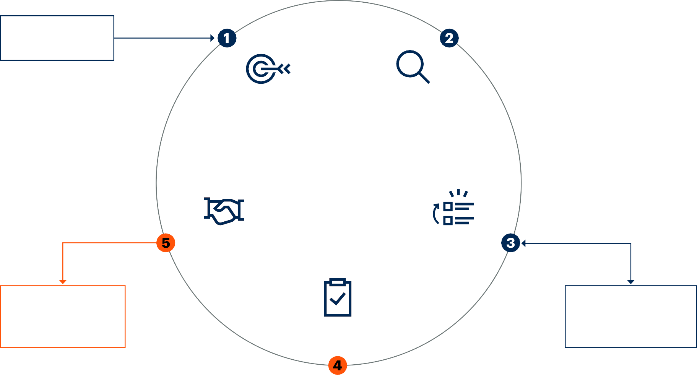
Continuous Threat Exposure Management
Cyber-Risk Management
Drive
Scoping
Discovery
D
i
a
g
n
o
s
e
CTEM
Initiate
A
Enrich
c
t
Mobilization
i
Prioritization
o
n
Treatments and Security Posture Optimization
Threat Detection Investigation and Response (TDIR)
Validation

Slide 12

University of Westminster
University of Westminster moved from a reactive to a proactive approach to cybersecurity by giving real-time visibility of IT assets to the IT team. They have extended the patch management program to facilitate the patching of more than 5,000 assets
The effort was made to also include assets that weren’t managed by the IT team and they had a critical need to identify and decommission end-of-life assets. Leveraging a new tool, they improved their ability to measure the exposure of their assets.
Source: Gartner Case Study: Proactive Approach to Cybersecurity in Higher Education

Slide 13

European Midsize Organizations*
The upcoming Tiber-EU framework includes requirements to reduce gaps found in security posture to days instead of months. This appears out of reach for midsize organizations without well-staffed security operation teams, and not dedicated “red team”.
Expanding from successful pilot of breach and attack simulation, these organizations expanded on the tool to build regular (monthly or even weekly) and automated cybersecurity validation assessments, in addition to their mandatory quarterly penetration testing assessments
*Aggregate example generated from analyst interactions with many relevant companies.

Slide 14
Continuous Threat Exposure Management
Scoping before discovery enables better long-term scale management
Integrate continuous threat exposure management principles progressively
Adopt the “attacker’s view” to assess the effectiveness of key security controls
Improving mobilization starts with security champions and requires to offer a range of tactical and strategic remediations

Slide 15
3
Protect the Future
Use Sustainable Technology
Prevent undesired outcome at scale – societally and environmentally
Sustainable use of technology increases digital maturity (74%), helps resilience (86%)
Start with material, high-importance issues – even if it hurts a bit

Slide 16
Sustainable Technology Framework
Social
DEI
Poverty
Humanitarianism
Health
Education
Energy
Risk
Biodiversity
Technology
Reporting
Water
Environmental
Compliance
Governance
Climate
Privacy
Circularity
Identity

Slide 17

Vodafone | Sustainable IT Operations
Performance analytics insights from common IT tools can be used proactively to manage equipment life cycles and defer the premature hardware refresh, avoiding unnecessary spend and e-waste through maximized life cycles.
Source: Vodafone Drives Sustainability in their Data Centers, Sunbird.

Slide 18

Cisco | Sustainable Enterprise Operations
Cisco adapted fundamental approaches to the role of its real estate in its business. It used digital solutions to design and manage its real estate to enhance worker productivity and satisfaction while reducing its demands on the environment.
Source: Cisco Connected Workplace Project, Cisco.

Slide 19

AgroScout | Sustainable Customer Operations
AgroScout has developed an artificial intelligence (AI) system that places climate and crop management directly into the hands of food processing companies, farm managers and farmers.
Source: AI to Remotely Protect Crops, GreenBiz.

Slide 20
Sustainable Technology
Leverage sustainable technology to improve quality, scale and impact beyond what spreadsheets can provide.
Identify the sustainable technologies needed by starting with material issues. Prioritize technology investments in material issues that are identified as very high in importance.
Support cost optimization and rationalization efforts by using sustainable technologies to aggregate and track critical performance and usage data, such as server/storage utilization and the number of end-user devices per employee.
Invest in emerging technologies and engage with emerging vendors at a rapid pace — aiming to validate and scale new solutions as fast as possible.
Initiate or reinvigorate the sustainable IT program to explore new sustainable business models and products.

Slide 21
Platform Engineering
AI-Augmented Development
AI Trust, Risk, Security Management
Machine Customers
Industry Cloud Platforms
Intelligent Applications
Rise of the Builders
Continuous Threat Exposure Management
Sustainable Technology
Augmented Connected Workforce
Democratized Generative AI
Notes:
As we ensure our efforts are preserved, on that basis we can build. A trusted foundation and powerful tools at our disposal, now we can ….

Slide 22
4
Developer-Driven Self-Service
Platform Engineering
Dedicated teams create tailored, responsive platforms that operate in an integrated fashion
Reduce cognitive load, improved productivity, UX and talent retention
Create a product management culture with routine engineer and end-user collaboration

Slide 23
Diagram of Platform Engineering
Team
Components
Consumption Direction
Product and Service Teams
X-as-a-Service
Developer Portal
Reusable Components
Tools
Platform Services
Knowledge
Platform Team(s)
Digital Platform
Infrastructure Platform
Infrastructure Complexity

Slide 24
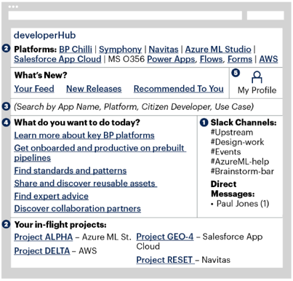
BP | Platform-Enabled Citizen Development
BP deployed and manages a balanced, broad portfolio of platforms to support a diverse range of use cases, business needs and stakeholder capabilities.
BP designs platforms with features and offerings that match the specific needs and capabilities of the intended user groups.
BP’s business units with at least one business-led development project in-flight went from 50% to 80%.
Source: Platform-Enabled Citizen Development (BP), Gartner.

Slide 25
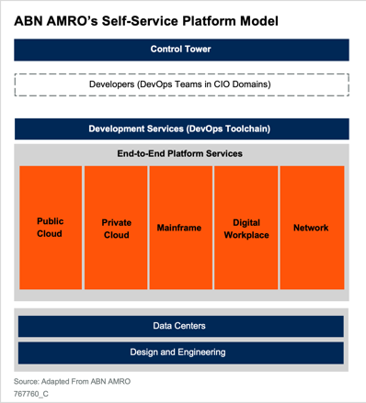
ABN AMRO | Self-Service Infrastructure Platforms
Photo or graphic (For photos please provide some keywords for our team to source)
ABN AMRO designed adaptive and self-service infrastructure platforms that eases developers’ ability to independently run, manage and develop their applications — while ensuring reliability and security.
Empower platform teams with end-to-end responsibility to ensure a continuously evolving platform that meets user needs.
ABN AMRO saw an improvement in their deployment speed and increased employee productivity and engagement.
Source: Self-Service Infrastructure Platforms to Accelerate Delivery (ABN AMRO), Gartner.

Slide 26
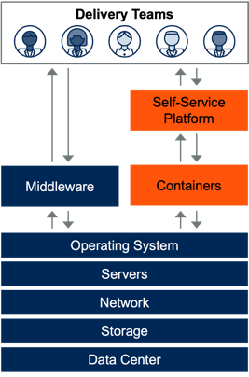
Politiet | Infrastructure Platform Teams
Self-service development platform, from a well-defined platform team, provides paved road to production.
Significant reduction in number of tickets raised by application developers from multiple per day to one per year.
Significant decrease in new application production deployment time from months to seconds.
Source: Infrastructure Platform Teams for Self-Service Delivery (Politiet), Gartner.

Slide 27
Platform Engineering
Treat the platform as a product. Appoint a product owner to analyze user and developer experience of using complex technology to find pain points. Implement the thinnest viable platforms to address the biggest pain points.
Establish dedicated platform teams. They will curate and build internal platforms with application components, tools, knowledge and services.
Embed security and architecture into platforms Security and architecture teams must “shift left,” embedding controls and guardrails into the production workflow, or paved road, as early as possible.
Make the platform easy to use and self service. Concentrate on making the platform compelling and easy to use without users needing tickets or experts. Use internal developer portals to ease discovery and use of the platforms.
Evolve platforms with user feedback. Continuously measure satisfaction, adoption and success of the platforms with the users to prioritize work and investments.

Slide 28
5
Accelerate Creation
AI-Augmented Development
Embed AI in support of software design, code, development and testing
Stretched engineers are equipped for more reliable product release
Invest in (Generative) AI technology that supports most of the software development lifecycle

Slide 29
Three Components of AI-Augmented Development
Design-to- Code Tools
AI-Augmented Development
AI Coding Assistants
AI-Augmented Testing Tools

Slide 30
Accelerators/Inhibitors of AI-Augmented Development
Accelerators
Additional code generation
Reduction of repetitive tasks
Resolution of high-level problems
Faster, better testing
Inhibitors
Cultural resistance
Market confusion
Inappropriate use
Error-prone models

Slide 31
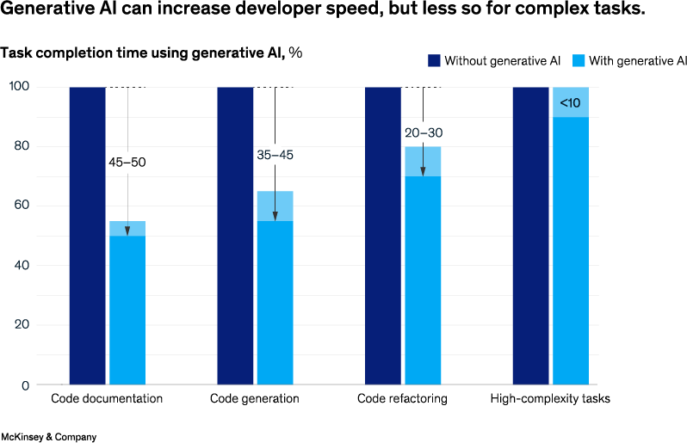
McKinsey | AI-Augmented Development
McKinsey set up a lab with 40 McKinsey developers
Asked to perform software development tasks in three areas:
Code generation
Refactoring
Documentation
Control group with no access to tools
Test group with access to two generative AI tools
Developers switched roles from control group and test group
Source: Unleashing Developer Productivity With Generative AI, McKinsey Digital.

Slide 32

Large Enterprise Development Team*
Several U.S.-based firms with a large number of developers
Category: AI-augmented code generation
Product deployed: GitHub Copilot
Measured average gains:
17% to 20% increased productivity
$2M cost savings/year
90+% reported one to two hours of time saving per week
50% to 75% reported improved developer experience
*Aggregate example generated from analyst interactions with many relevant companies.

Slide 33
AI-Augmented Development
Assume that use of these tools will lead to greater demand for software engineers and manage the change process for adoption of AI-augmented development, as teams may be resistant to adopt these tools.
Establish a team of senior software engineers who can evaluate AI code generation tools to determine the best way to deploy and use these tools.
Evaluate and deploy AI testing tools, as these will become mandatory elements of your application testing processes.
Select or establish a design system with reusable UI design and front-end components, and enable this design system with design-to-code capabilities.
Plan for continued rapid improvement of AI-augmented development tools, as models will be updated on a fast cadence.
Continually evaluate new tools for AI-augmented development, as new tools will continue to emerge.

Slide 34
6
Tailor Your Tailor’s Work
Industry Cloud Platforms
Software, Platform & Infrastructure in a composable product
Cloud offering turns from technology value to direct business value
Refine precision and scale of industry-specific innovations

Slide 35
Industry Cloud Platform Evolution
Industry Cloud Platforms
Industry Cloud Platform Innovations
Marketplaces Composable Intelligence
Sustainable Anywhere
PBCs/APIs
Compliance
Data Fabric
Fusion Teams
Infrastructure
Area 1: SaaS
Area 2: PaaS
Area 3: laaS
Applications
Business Departments
Digital Transformation Developers, Business Technologists
Current Data Center Load IT Infrastructure and Operations
Traditional Enterprise Cloud Categories

Slide 36

Case Example
Minna Bank | Cloud-Based Banking
Minna Bank partnered with Accenture to create a fully digital and cloud-based banking platform to cater to a new generation of digitally demanding millennial and Generation Z customers.
Minna Bank went live within 18 months, despite Japan’s significant regulatory requirements, and opened 400,000 accounts in the first year of operation.
The “Zero Bank Core Solution” is built on Google Cloud Platform and includes complementary banking capabilities built on several SaaS, PaaS and IaaS providers.
Source: Minna Bank’s Digital Banking Service Attracts Over 400 Thousand Accounts in First Year of Operation, Bloomberg.

Slide 37

Case Example
The Żabka Group | Autonomous Shopping
The Żabka Group operates over 9,000 convenience stores in Poland and has been adding autonomous “Nano” stores across the nation.
These check-out-free stores range from traditional brick-and-mortar shops, to store-in-store outlets and stand-alone vending containers.
Żabka leverages Microsoft Cloud for Retail with technology developed by Microsoft partner AiFi. The instant data capture enables Żabka to quickly adapt — shaping expectations with their customers in a personalized way.
Source: Zabka Group Launches Autonomous Nano Stores Powered by AiFi and Microsoft Cloud for Retail, Gains High Customer Ratings, Microsoft.

Slide 38

Case Example
Bethesda Health Care | Care at Home Support
Bethesda Health Care used capabilities from Microsoft Cloud for Healthcare and Velrada to build a new patient administration system (PAS).
The PAS supports care at home by digitally connecting all the participants in a patient’s care, including the patient, families, doctors, social workers, community organizations and care payers.
The system will improve how patients can access and receive care support, as well as how they and their families interact with care teams.
Sources: Bethesda Health Care taps Microsoft for PAS, Healthcare IT News; Bethesda Health Care Puts Patients First With the New Bethesda Clinic and Cloud for Healthcare, Microsoft Cloud (via YouTube)

Slide 39
Industry Cloud Platforms
Approach industry cloud platforms as a way to add new capabilities to your portfolio, rather than as a replacement (think exoskeleton).
Engage business technologists and fusion teams to create enterprisewide support for the industry cloud journey.
Articulate when to deploy for optimization (as-is) and when to deploy for transformation (recomposed).
Start building composability skills and pursue radical modularity to address lock-in and other concerns.

Slide 40
Platform Engineering
AI-Augmented Development
AI Trust, Risk, Security Management
Machine Customers
Industry Cloud Platforms
Intelligent Applications
Deliver
the Value
Continuous Threat Exposure Management
Sustainable Technology
Augmented Connected Workforce
Democratized Generative AI

Slide 41
7
Optimize Decision-Making
Intelligent Applications
(Gen) AI-embedded functions become foundational application features
Continuous learning for adaptive, predictive, contextual and/or personalized experience
Rank the tasks where AI-embedded functions in applications improve business outcome

Slide 42
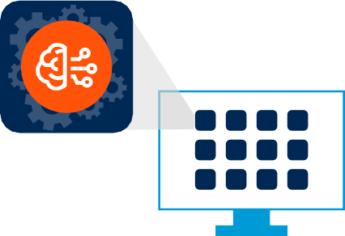
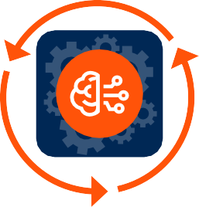
Intelligent Applications
Intelligence is a foundational capability for applications.
Intelligent applications better automate and augment work across a broader range of use cases.
Applications do more, much of which is done independently either by themselves, or with other applications.

Slide 43

Dexcom | Recruiting (HR) With Intelligent Applications
Dexcom wanted to streamline its company's recruiting process to find the best qualified candidates for positions.
It implemented Eightfold AI's Talent Intelligence platform together with SAP SuccessFactors, which augmented the application and hiring process.
This resulted in a 40% conversion of all website visitors to unique job applicants in the first six months since go-live, and 42% of career site visitors submitted a resume within the same timeframe.
Source: Filling Critical Roles Fast With AI, eightfold.ai.

Slide 44

L’Oréal | E-Commerce With Intelligent Applications
L’Oréal wanted to personalize shoppers' experiences while ensuring that their data privacy was secure.
It used Salesforce's Einstein AI to create product recommendations based on a shopper's browsing or purchasing history.
This resulted in 15%-20% of sales in one of L’Oréal's B2C brands, doubled average order value from its B2C websites, and increased customer service agent satisfaction ratings by up to 70%.
Source: L'Oréal Creates Unique Beauty Experiences With a Data-driven Approach, Salesforce.

Slide 45

CallRail | B2B Machine Customer Platform
CallRail wanted to use integrated AI features to augment and further enhance its call tracking and analytics capabilities in its products.
It partnered with Assembly AI, who provided models for automatic transcription, PII redaction and automatic transcript highlight ability.
This resulted in CallRail improving its transcription accuracy by up to 23%, and increased usage of its Conversation Intelligence product.
Source: How CallRail Doubled its Conversation Intelligence Customers by Building With a Trusted AI Partner, AssemblyAI.

Slide 46
Intelligent Applications
Proceed with caution due to the nascency of the underlying technologies by being selective in accepting updates and additions, in keeping with aligned governance. Test through pilot and proof-of-concept programs to determine the extent to which capabilities will have a positive impact on the applications.
Assess how intelligent applications will transform the scope, purpose and functionality of your enterprise applications by engaging with relevant stakeholders and suppliers. Establish a clear and shared understanding of intelligent applications and their potential use cases throughout your organization.
Re-establish the balance between risk and opportunity by adapting your governance policies to address application intelligence. Do so directly if your role permits, or by influencing others if it does not.
Evaluate the impact on your wider portfolio of applications and services as you expand the range and scope of intelligent applications in the medium to long term. Do so by working with enterprise architects to rationalize and consolidate your application portfolio.

Slide 47
8
Power AND Responsibility
Democratized Generative AI
Low barrier entry to generate, create, compose literally anything digital
Cost reduction, new products, refine & improve experience, productivity
Have a deliberate, purposeful approach to using this power

Slide 48
Democratized Generative AI
Democratized Generative AI
Users
Business users will have ubiquitous access to knowledge and technical skills that wasn’t possible before, heralding a new wave of productivity.
Technology
The confluence of cloud and open source will make generative AI more
democratized in the future beyond the purview of large technology giants.
Governance
This unfettered access to knowledge and skills must be underpinned by a strong focus on governance and responsible AI practices.
New Regulations and Self-Governance​
Workforce Productivity​
Every Business Will be an AI Business​

Slide 49


Democratized Generative AI — Risks and Benefits
Risks
Benefits
Loss of confidential data
Hallucination
Blackbox
Copyright issues
Potential for misuse and unintended consequences
Workforce productivity
Multidomain applications
Democratization of Information and skills
Innovative ecosystem
The Challenges Are Nontrivial for Enterprise Deployments

Slide 50

PwC | AI Generated Legal Assistance
PwC had a global partnership with artificial intelligence (AI) startup Harvey, providing PwC’s Legal Business Solutions professionals exclusive access.
PwC worked with Harvey to take the platform to market to help clients further streamline their in-house legal processes. PwC also looked to develop and train its own proprietary AI models with Harvey to create customized products and services for its own use cases and for clients across Legal Business Solutions.
The use of Generative AI democratized information access and enhanced the ability of PwC’s network of more than 4,000 legal professionals to deliver human-led and technology-enabled legal solutions in a range of areas, including contract analysis, regulatory compliance, claims management, due diligence, and broader legal advisory and legal consulting services.
Source: PwC Announces Strategic Alliance With Harvey, Positioning PwC’s Legal Business Solutions at the Forefront of Legal Generative AI, PWC.

Slide 51

CarMax | Customer Experience
The omnichannel used-car retailer is increasing customer prospecting efforts and enhancing the customer experience through its adoption of Azure OpenAI and the language models behind ChatGPT.
The CarMax team employed GPT 3.5’s enhanced “iteration on prompts” to feed scrubbed and formatted data for thousands of used cars into a DaVinci model. Following that, a small dataset was sent for editing and fine-tuning and the content was pumped into the DaVinci model for mass publishing and consumer consumption, enabling better search and transparent information to the users.
The use of Generative AI resulted in an increase in their customer engagement and traffic and the company was also able to realize IT cost benefits, in addition to content creation savings.
Source: Build: Azure OpenAI Service Helps Customers Accelerate Innovation With Large AI Models; Microsoft Expands Availability, Microsoft.

Slide 52
Democratized Generative AI
Create a prioritized matrix of GenAI use cases in your industry vertical based on technical feasibility and tangible business value. Identify business functions and tasks with immediate impact and savings. Outline a timeframe for piloting, deployment and production across these use cases.​
Quantify the business value of generative AI using both technical and business metrics and measure it early and in a consistent manner. ​
Employ a change management approach that prioritizes employee training and well-being. Do so by equipping employees with the knowledge to use GenAI tools safely and confidently, while showing them that these tools will help them automate routine tasks. ​
Implement governance to enable democratization in a responsible way — ensure there are checks and balances for content accuracy, authenticity and guardrails to prevent intended or unintended consequences of the GenAI applications with humans in the loop. ​​

Slide 53
9
Push the Pioneers
Augmented Connected Workforce
Onboarding, training, productivity supported in automated fashion, incl. nudging for performance and well-being
Augment for SLA, quality and response improvement, baseline of work and productivity
Optimization of effect through digital employee experience (DEX)

Slide 54
Connected Workers Anchor Employee Engagement
l
P
a
h
t
y
i
Context Decisions Standard Work
s
g
i
i
c
D
a
l
Connected Through Technology
Applications, Mobile Devices, Wearables, Analytics, Workflow
Governance
Knowledge
Talent Management and Organization Design
Learning and Development
Curation

Slide 55

Home Depot | Augmented Connected Associate
Home Depot has deployed a mobile app called Sidekick, which helps store associates prioritize tasks.
Sidekick also uses intelligence services like machine learning and computer vision to help associates identify out-of-stock items and complete other tasks.
Home Depot has a design tenet focused on delivering intuitive user experience built for “Day 1 Associates.”
The Home Depot application development team has prioritized internal development to focus on employee feedback and integration of the tech stack.
Source: The Home Depot Launches New In-Store Application to Help Associates Provide Better Customer Experience, The Home Depot.

Slide 56
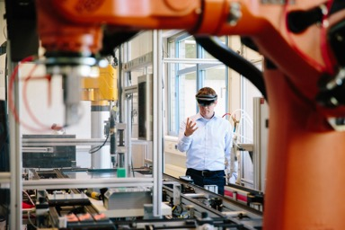
Merck | Maximizing Shopfloor Human Performance
Merck has a dedicated program for extended reality, designed to maximize employee time. The program was developed with HR and L&D partners, business unit leads and operations.
Frontline workers champion use cases across knowledge transfer, testing and training.
Each manufacturing site is provided templates to guide deployment and change management.
Success metrics: 70% of SME time redirected from non-value-added work; two weeks' time savings for training and time to competence.
TO BE UPDATED
Source: Bringing Innovation to Production: Maximizing Shopfloor Human Performance, PTC.

Slide 57

EY | Augmented Tax
EY developed its Tax Copilot program with co-creation of technology solutions in mind, so tax professionals gain innovation and technology skills.
Leverages EY Fabric, a platform with shared low-code, data and other technology assets.
Employees work on responsible use cases for generative AI to enable better work.
New 2023 initiative, but targeted outcomes include process and service improvements for tax services.
Source: EY Unlocks Microsoft Azure OpenAI Service to Empower EY Tax Professionals Globally With EY Tax Copilot, EY.

Slide 58
Augmented Connected Workforce
Create a cross-functional program consisting of leaders from IT, HR, sales, customer service and supply chain to decide which workforce segments to prioritize investment in, and which outcomes to pursue.
Build support for augmented connected workforce investments by prioritizing time to competency for inexperienced workers who perform in highly complex environments and quantifying results, such as faster onboarding.
Meet the diversity of skills, roles and jobs needed by developing a broad array of use cases, anchored by standard work. This lays the foundation for automating non-value-added tasks and enabling data and tools to improve workforce development and decision making.
Design digital employee experiences that are augmented with intelligent technology by using DEX disciplines like journey mapping and persona modeling.

Slide 59
10
Buyers with Byte(s)
Machine Customers
Machines empowered and designed to make deals, purchase goods
A new, automated market approach to win the favor of machines
Construct bot responsive platforms, your own clients

Slide 60
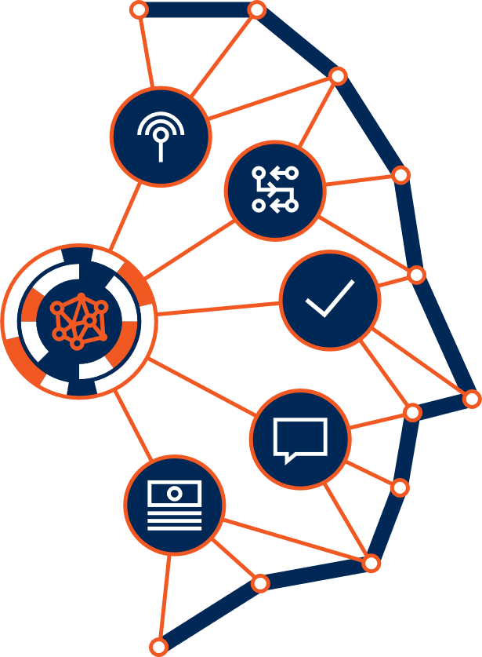
Machine Customer Evolution
Bound
Purchase specific items, as defined by rules.
Adaptable
Make optimized selections among competing products, based on rules.
Autonomous
Infer customer needs, based on rules, context and preferences. Has its own needs.
Today
2022-2025
2036
Machine Customer
Clearly Defined Choices
Human leads, machine executes.
Competing Choices
Both lead, machine executes.
Inferred Needs
Machine leads and executes.

Slide 61
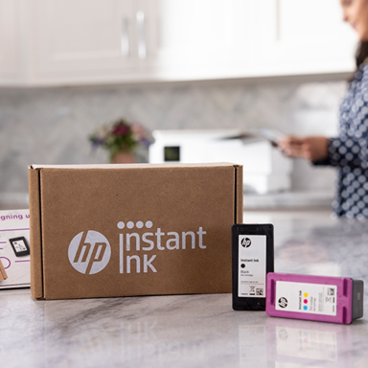
HP Inc. | B2C Machine Customer Purchasing
“Instant Ink” was launched in 2013, enabling connected printers to automatically order their own ink when supplies run low. The premise is simple: pay monthly, based on how many pages you print, and delegate ink purchasing to the machine.
11 million subscribers have ink delivered to their door before they run out. The entire transaction takes place without any human intervention. And, HP has added paper to the service in some markets.
Source: Gartner book, When Machines Become Customers.

Slide 62

Walmart | AI-Powered Negotiations
Walmart has deployed AI-powered negotiations software with a text-based interface (i.e., a chatbot) to connect with suppliers of “goods not for resale” — categories such as fleet services, carts and other equipment used in retail stores.
So far, the chatbot is negotiating and has closed agreements with 68% of suppliers approached, with each side gaining something it values.
Source: How Walmart Automated Supplier Negotiations, Harvard Business Review.

Slide 63

iProd | B2B Machine Customer Platform
Italy-based iProd created iProdMOP, the first platform that can accommodate the requests of machine customers located in a manufacturing environment.
The platform allows the machine to automatically purchase what it needs from its manufacturer or the iProd IOT Marketplace. Purchases are based on the production plans assigned to the asset and controlled by the iProd platform when it is equipped with an electronic system, such as a computerized numerical control (CNC), programmable logic controllers (PLCs) or digital sensors, and interconnected to the IoT tablet.
Source: iProd Manufacturing Companies, iProd.

Slide 64
Machine Customers
Create a machine customer investigation team. Enlist senior representatives from strategy, IT, product development, sales and service.
Create one to three scenarios that explore the market opportunities.
Prototype, market-test and evolve machine customers using a lean startup approach, if the position of your company in its industry makes that an option.
Now: Start architecting the data sources and API platform needed to serve machine customers that should not, or will not, use your human-readable digital storefront. Become exceptional at digital commerce by adding machines and human-machine customer journeys to the mix.

Slide 65
Create Your Story Roadmap Toward Purpose

Slide 66
Create Your Story – Roadmap Toward Purpose
AI TRiSM
Continuous Threat Exposure Management
Connected-Augmented Workforce
Democratized GenAI
Strategies and Goals
Sustainable Technology
Machine Customers
Platform Engineering
Industry Cloud Platforms
Intelligent Applications
AI-Augmented Development

Slide 67
Create Your Story – Roadmap Toward Purpose
Enhance Resilience
AI TRiSM
Continuous Threat Exposure Management
Connected-Augmented Workforce
Maximize Value From Data
Democratized GenAI
Sustainable/DEI
Sustainable Technology
Attract and Retain Talent/FoW
Machine Customers
Platform Engineering
Driving Growth
Accelerate Digital
Industry Cloud Platforms
Intelligent Applications
AI-Augmented Development

Slide 68
Create Your Story – Roadmap Toward Purpose
Enhance Resilience
AI TRiSM
Continuous Threat Exposure Management
Connected-Augmented Workforce
Maximize Value From Data
Democratized GenAI
Sustainable/DEI
Sustainable Technology
Attract and Retain Talent/FoW
Machine Customers
Platform Engineering
Driving Growth
Accelerate Digital
Industry Cloud Platforms
Intelligent Applications
AI-Augmented Development
Now
0-1 year
1-2 years
2-3 years

Slide 69
Create Your Story – Roadmap Toward Purpose
Enhance Resilience
AI TRiSM
Continuous Threat Exposure Management
Connected-Augmented Workforce
Maximize Value From Data
Democratized GenAI
Sustainable/DEI
Sustainable Technology
Attract and Retain Talent /FoW
Machine Customers
Platform Engineering
Driving
Growth
Accelerate Digital
Industry Cloud Platforms
Intelligent Applications
AI-Augmented Development
Now
0-1 year
1-2 years
2-3 years

